Slide 1
Java programming
What is Java?
Java is a programming language and a platform. Java is a high level, robust, object-oriented and secure programming language.
Java was developed by Sun Microsystems (which is now the subsidiary of Oracle) in the year 1995. James Gosling is known as the father of Java.
Platform: Any hardware or software environment in which a program runs, is known as a platform. Since Java has a runtime environment (JRE) and API, it is called a platform.
Application
Desktop Applications such as acrobat reader, media player, antivirus, etc.
Web Applications such as irctc.co.in, javatpoint.com, etc.
Enterprise Applications such as banking applications.
Mobile
Embedded System
Smart Card
Robotics
Games, etc.
Features of Java
Simple
Java is very easy to learn, and its syntax is simple, clean and easy to understand. According to Sun Microsystem, Java language is a simple programming language because:
Java syntax is based on C++ (so easier for programmers to learn it after C++).

Slide 2
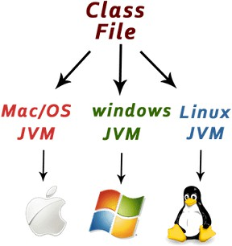
Java has removed many complicated and rarely-used features, for example, explicit pointers, operator overloading, etc.
There is no need to remove unreferenced objects because there is an Automatic Garbage Collection in Java.
Object-oriented
Java is an object-oriented programming language. Everything in Java is an object. Object-oriented means we organize our software as a combination of different types of objects that incorporate both data and behaviour.
Platform Independent
Java is platform independent because it is different from other languages
like C, C++, etc. which are compiled into platform specific machines while Java is a write once, run anywhere language. A platform is the hardware or software environment in which a program runs.
Secured
Java is best known for its security. With Java, we can develop virus-free systems. Java is secured because:
No explicit pointer
Java Programs run inside a virtual machine sandbox
Robust
The English mining of Robust is strong. Java is robust because:

Slide 3
It uses strong memory management.
There is a lack of pointers that avoids security problems.
Java provides automatic garbage collection which runs on the Java Virtual Machine to get rid of objects which are not being used by a Java application anymore.
Architecture-natural
Java is architecture natural because there are no implementation dependent features, for example, the size of primitive types is fixed.
Portable
Java is portable because it facilitates you to carry the Java bytecode to any platform. It doesn't require any implementation.
High-performance
Java is faster than other traditional interpreted programming languages because Java bytecode is "close" to native code.
Distributed
Java is distributed because it facilitates users to create distributed applications in Java.
Multi-threaded
A thread is like a separate program, executing concurrently. We can write Java programs that deal with many tasks at once by defining multiple threads.
Dynamic
Java is a dynamic language. It supports the dynamic loading of classes. It means classes are loaded on demand. It also supports functions from its native languages, i.e., C and C++.

Slide 4
First Java Program
public class ClassName{
public static void main(String args[]) {
System.out.println(“ Hi Hello Welcome To Our Class”);
}
}
class keyword is used to declare a class in Java.
public keyword is an access modifier that represents visibility. It means it is visible to all.
static is a keyword. If we declare any method as static, it is known as the static method. The core advantage of the static method is that there is no need to create an object to invoke the static method. The main() method is executed by the JVM, so it doesn't require creating an object to invoke the main() method. So, it saves memory.
void is the return type of the method. It means it doesn't return any value.
main represents the starting point of the program.
String[] args or String args[] is used for command line argument.
System.out.println() is used to print statement. Here, System is a class, out is an object of the PrintStream class, println() is a method of the PrintStream class.

Slide 5
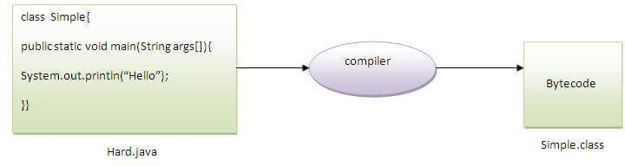
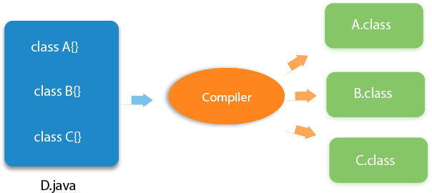
Q) Can you save a Java source file by another name than the class name?
Yes, if the class is not public. It is explained in the figure given below:
Q) Can you have multiple classes in a java source file?
Yes, like the figure given below illustrates:
Difference between JDK, JRE, and JVM
JVM
JVM (Java Virtual Machine) is an abstract machine. It is called a virtual machine because it doesn't physically exist. It is a specification that provides a runtime environment

Slide 6
JRE
JRE is an acronym for Java Runtime Environment. It is also written as Java RTE. The Java Runtime Environment is a set of software tools which are used for developing Java applications. It is used to provide the runtime environment.
JDK
JDK is an acronym for Java Development Kit. The Java Development Kit (JDK) is a software development environment which is used to develop Java applications and applets. It physically exists. It contains JRE + development tools.
Java Variables
A variable is a container which holds the value while the Java program is executed. A variable is assigned with a data type.
Variable is a name of memory location. There are three types of variables in java: local, instance and static.
Local Variable
A variable declared inside the body of the method is called local variable. You can use this variable only within that method and the other methods in the class aren't even aware that the variable exists.
A local variable cannot be defined with "static" keyword.
Instance Variable
A variable declared inside the class but outside the body of the method, is called an instance variable. It is not declared as static.
Static variable
A variable that is declared as static is called a static variable. It cannot be local. You can create a single copy of the static variable and share it among all the instances of the class.

Slide 7
Data Types in Java
Data types specify the different sizes and values that can be stored in the variable. There are two types of data types in Java:
Primitive data types: The primitive data types include boolean, char, byte, short, int, long, float and double.
Non-primitive data types: The non-primitive data types include Classes, Strings, Interfaces, and Arrays.
Operators in Java
Operator in Java is a symbol that is used to perform operations. For example: +, -, *, / etc.
There are many types of operators in Java which are given below:
Unary Operator,
Arithmetic Operator,
Shift Operator,
Relational Operator,
Bitwise Operator,
Logical Operator,
Ternary Operator and
Assignment Operator.
Java Keywords
Java keywords are also known as reserved words. Keywords are particular words that act as a key to a code. These are predefined words by Java so they cannot be used as a variable or object name or class name

Slide 8
int: Primitive data type representing 32-bit signed integers. interface: Used to declare an interface. long: Primitive data type representing 64-bit signed integers. native: Used to declare native methods. new: Used to create new objects. null: Represents the absence of a reference. package: Used to define a package. private: Access modifier for private members. protected: Access modifier for protected members. public: Access modifier for public members. return: Used to return a value from a method. short: Primitive data type representing 16-bit signed integers. static: Used to declare static members. strictfp: Used to enforce strict floating-point precision. super: Used to refer to the parent class. switch: Used to create a switch statement. synchronized: Used to synchronize access to shared resources. this: Used to refer to the current object. throw: Used to throw an exception. throws: Used to declare exceptions that a method may. try: Used to start a try-catch block. void: Used to indicate that a method does not return a value.
.

Slide 9
Java Control Statements | Control Flow in Java
Java provides three types of control flow statements.
Decision Making statements
if statements
switch statement
Loop statements
do while loop
while loop
for loop
for-each loop
Jump statements
break statement
continue statement
Decision-Making statements:
As the name suggests, decision-making statements decide which statement to execute and when.
If Statement:
In Java, the "if" statement is used to evaluate a condition. The control of the program is diverted depending upon the specific condition. The condition of the If statement gives a Boolean value, either true or false.
if-else statement
The if-else statement is an extension to the if-statement, which uses another block of code, i.e., else block.
if-else-if ladder:
The if-else-if statement contains the if-statement followed by multiple else- if statements. In other words, we can say that it is the chain of if-else

Slide 10
statements that create a decision tree where the program may enter in the block of code where the condition is true.
Nested if-statement
In nested if-statements, the if statement can contain a if or if-else statement inside another if or else-if statement.
Switch Statement:
In Java, Switch statements are similar to if-else-if statements. The switch statement contains multiple blocks of code called cases and a single case is executed based on the variable which is being switched.
Loop Statements
In programming, sometimes we need to execute the block of code repeatedly while some condition evaluates to true. However, loop statements are used to execute the set of instructions in a repeated order.
for loop
while loop
do-while loop
Java for loop
In Java, for loop is similar to C and C++. It enables us to initialize the loop variable, check the condition, and increment/decrement in a single line of code. We use the for loop only when we exactly know the number of times, we want to execute the block of code.
Java for-each loop
Java provides an enhanced for loop to traverse the data structures like array or collection. In the for-each loop, we don't need to update the loop variable. The syntax to use the for-each loop in java is given below.
for(data_type var : array_name/collection_name){
//statements

Slide 11

ForLoopExample
public class ForLoopExample {
public static void main(String[] args) {
for (int i = 1; i <= 5; i++) {
System.out.println(i);
}
}
}
for (int i = 1; i <= 5; i++): This is the for loop statement.
int i = 1: Initializes a variable i with the value 1. This is executed only once, before the loop starts.
i <= 5: This is the condition. The loop continues as long as i is less than or equal to 5.
i++: Increments the value of i by 1 after each iteration.
System.out.println(i);: This line prints the current value of i to the console.

Slide 12
DoWhile Example
public class DoWhileExample {
public static void main(String[] args) {
int i = 1;
do {
System.out.println(i);
i++;
} while (i <= 5);
}
}
Explanation:
The i variable is initialized to 1.
The do block starts, and the value of i is printed.
The value of i is incremented by 1.
The condition i <= 5 is checked. Since i is currently 2, the condition is true, and the loop repeats.
This process continues until i becomes 6.
When i is 6, the condition i <= 5 becomes false, and the loop ends.

Slide 13
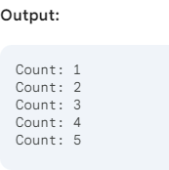
While Loop Example
Explanation:
Initialization: An integer variable count is declared and initialized to 1.
Condition Check: The while loop checks if the value of count is less than or equal to 5. If true, the loop body executes.
Loop Body: The current value of count is printed to the console.
Increment: The value of count is increased by 1.
Iteration: The loop repeats from step 2 until the condition becomes false (i.e., count is greater than 5).
public class WhileLoopExample {
public static void main(String[] args) {
int count = 1;
while (count <= 5) {
System.out.println("Count: " + count);
count++;
}
}
}

Slide 14
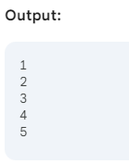
For Each Loop Example
public class ForEachLoopExample {
public static void main(String[] args) {
// Create an array of integers
int[] numbers = {1, 2, 3, 4, 5};
// Iterate over the array using for-each loop
for (int number : numbers) {
System.out.println(number);
}
}
}
Explanation:
Array creation: An integer array named numbers is created with values 1, 2, 3, 4, and 5.
For-each loop:
for (int number : numbers): This line declares a loop variable number of type int. The colon (:) indicates that number will take on the value of each element in the numbers array.
System.out.println(number): This line prints the current value of number to the console.

Slide 15
}
Java while loop
The while loop is also used to iterate over the number of statements multiple times. However, if we don't know the number of iterations in advance, it is recommended to use a while loop.
Java do-while loop
The do-while loop checks the condition at the end of the loop after executing the loop statements. When the number of iteration is not known and we have to execute the loop at least once, we can use do-while loop.
It is also known as the exit-controlled loop since the condition is not checked in advance. The syntax of the do-while loop is given below.
do
{
//statements
} while (condition);
Jump Statements
Jump statements are used to transfer the control of the program to the specific statements. In other words, jump statements transfer the execution control to the other part of the program.
Java break statement
As the name suggests, the break statement is used to break the current flow of the program and transfer the control to the next statement outside a loop or switch statement.
Java continue statement
Unlike break statement, the continue statement doesn't break the loop, whereas, it skips the specific part of the loop and jumps to the next iteration of the loop immediately.

Slide 16
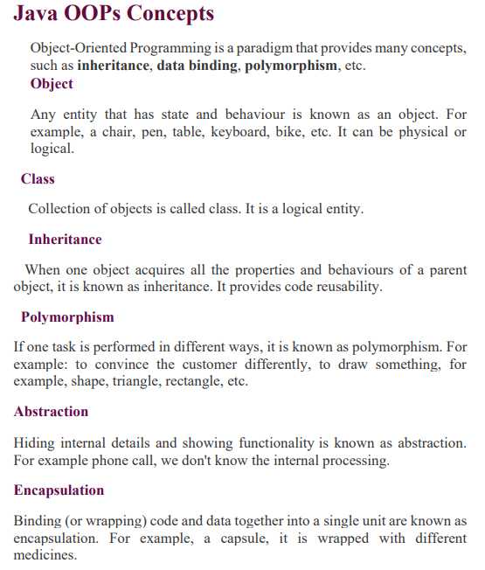

Slide 17
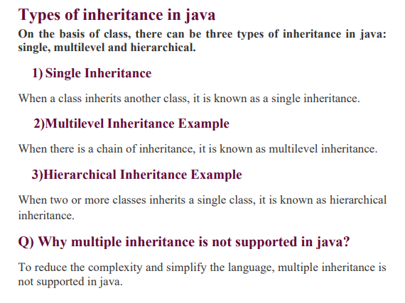

Slide 18
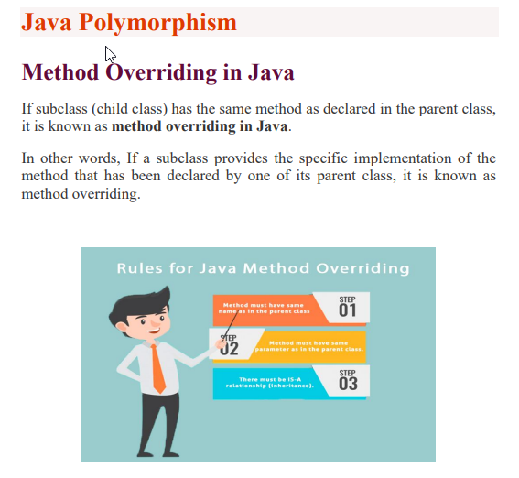

Slide 19
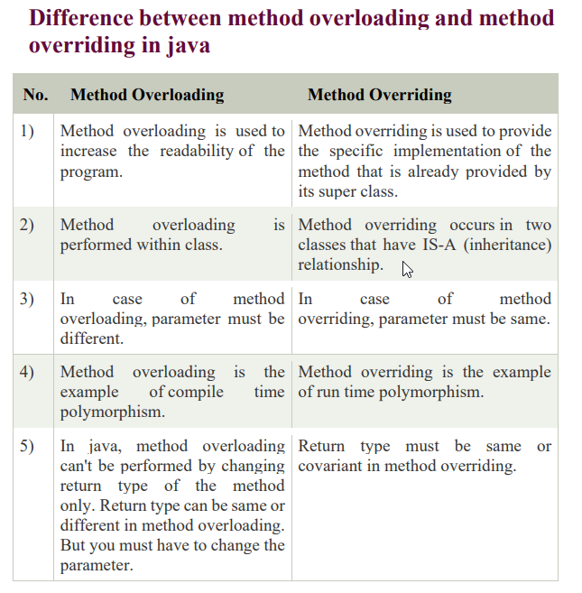

Slide 20
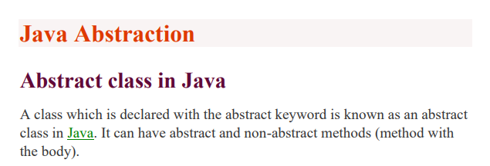
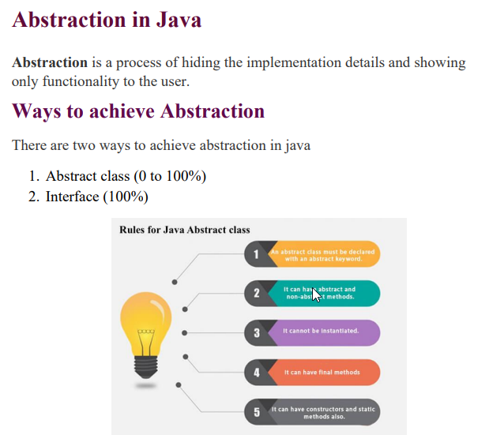

Slide 21
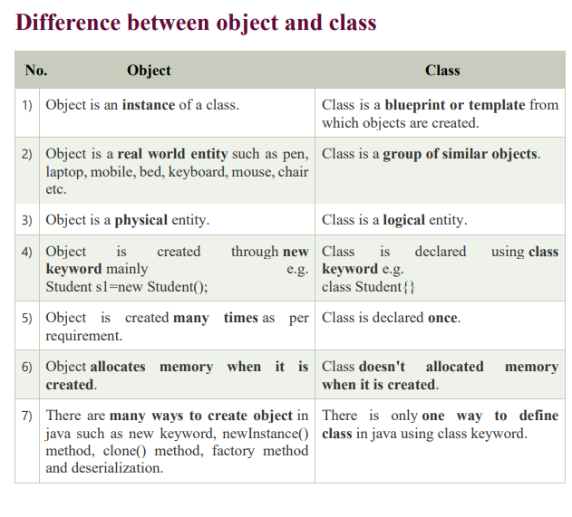

Slide 22
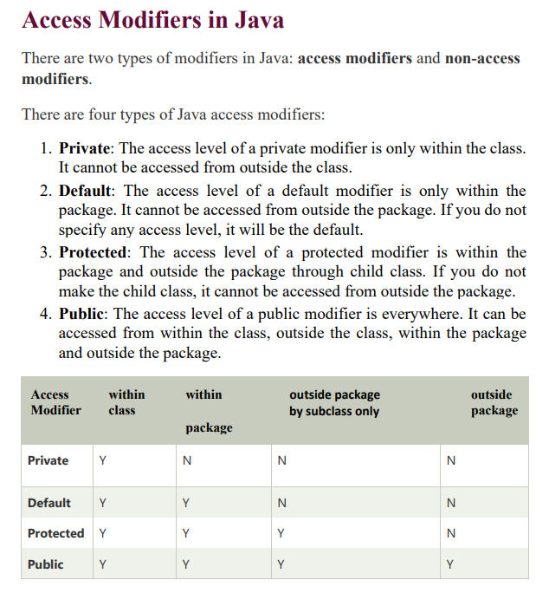

Slide 23
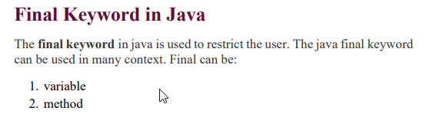
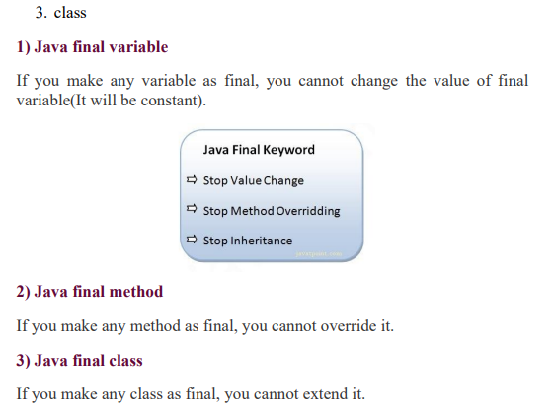

Slide 24
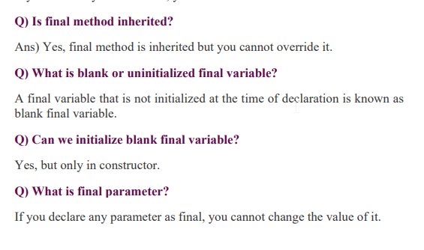


Slide 25
Java Object Class
Java OOPs Concepts
Object-Oriented Programming is a paradigm that provides many concepts, such as inheritance, data binding, polymorphism, etc.
Object
Any entity that has state and behaviour is known as an object. For example, a chair, pen, table, keyboard, bike, etc. It can be physical or logical.
Class
Collection of objects is called class. It is a logical entity.
Inheritance
When one object acquires all the properties and behaviours of a parent object, it is known as inheritance. It provides code reusability.
xample, a capsule, it is wrapped with different medicines.

Slide 26
Polymorphism
If one task is performed in different ways, it is known as polymorphism. For example: to convince the customer differently, to draw something, for example, shape, triangle, rectangle, etc.
Abstraction
Hiding internal details and showing functionality is known as abstraction. For example phone call, we don't know the internal processing.
Encapsulation
Binding (or wrapping) code and data together into a single unit are known as encapsulation. For e
Constructors in Java
In Java, a constructor is a block of codes similar to the method. It is called when an instance of the class is created. At the time of calling constructor, memory for the object is allocated in the memory.
Constructor Overloading in Java
Constructor overloading in Java is a technique of having more than one constructor with different parameter lists.

Slide 27
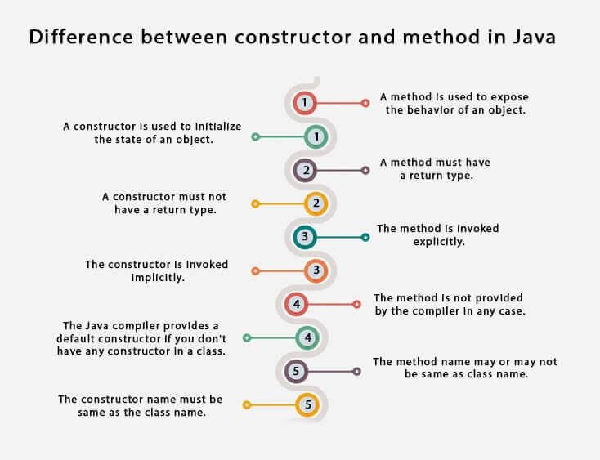
Different b/w Constructor and Method
Java static keyword
The static keyword in Java is used for memory management mainly. We can apply static keyword with variables, methods, blocks and nested

Slide 28
classes. The static keyword belongs to the class than an instance of the class.
Java static variable
If you declare any variable as static, it is known as a static variable.
The static variable can be used to refer to the common property of all objects (which is not unique for each object), for example, the company name of employees, college name of students, etc.
The static variable gets memory only once in the class area at the time of class loading.
Java static method
If you apply static keyword with any method, it is known as static method.
A static method belongs to the class rather than the object of a class.
A static method can be invoked without the need for creating an instance of a class.
A static method can access static data member and can change the value of it.
Q) Why is the Java main method static?
Ans) It is because the object is not required to call a static method. If it were a non-static method, JVM creates an object first then call main() method that will lead the problem of extra memory allocation.
3) Java static block
Is used to initialize the static data member.
It is executed before the main method at the time of classloading.

Slide 29
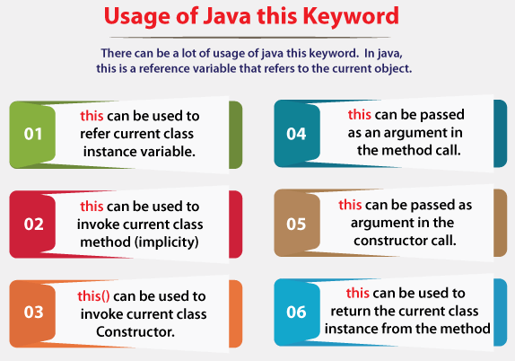
Q) Can we execute a program without main() method?
Ans) No, one of the ways was the static block, but it was possible till JDK
1.6. Since JDK 1.7, it is not possible to execute a Java class without the main method.
this keyword in Java
There can be a lot of usage of Java this keyword. In Java, this is a reference variable that refers to the current object.
Java Inheritance
Inheritance in Java
Inheritance in Java is a mechanism in which one object acquires all the properties and behaviours of a parent object.
Inheritance represents the IS-A relationship which is also known as a parent-child relationship.
Why use inheritance in java
For Method Overriding (so runtime polymorphism can be achieved).

Slide 30
For Code Reusability.
Types of inheritance in java
On the basis of class, there can be three types of inheritance in java: single, multilevel and hierarchical.
Single Inheritance
When a class inherits another class, it is known as a single inheritance.
Multilevel Inheritance Example
When there is a chain of inheritance, it is known as multilevel inheritance.
Hierarchical Inheritance Example
When two or more classes inherits a single class, it is known as hierarchical inheritance.
Q) Why multiple inheritance is not supported in java?
To reduce the complexity and simplify the language, multiple inheritance is not supported in java.
Aggregation in Java
If a class have an entity reference, it is known as Aggregation. Aggregation represents HAS-A relationship.
Method Overloading in Java
If a class has multiple methods having same name but different in parameters, it is known as Method Overloading.
If we have to perform only one operation, having same name of the methods increases the readability of the program.

Slide 31
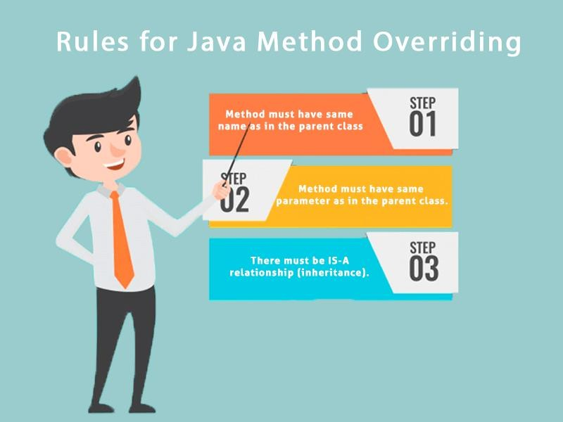
Q) Why Method Overloading is not possible by changing the return type of method only?
In java, method overloading is not possible by changing the return type of the method only because of ambiguity.
Q) Can we overload java main() method?
Yes, by method overloading. You can have any number of main methods in a class by method overloading. But JVM calls main() method which receives string array as arguments only.
Java Polymorphism
Method Overriding in Java
If subclass (child class) has the same method as declared in the parent class, it is known as method overriding in Java.
In other words, If a subclass provides the specific implementation of the method that has been declared by one of its parent class, it is known as method overriding.

Slide 32
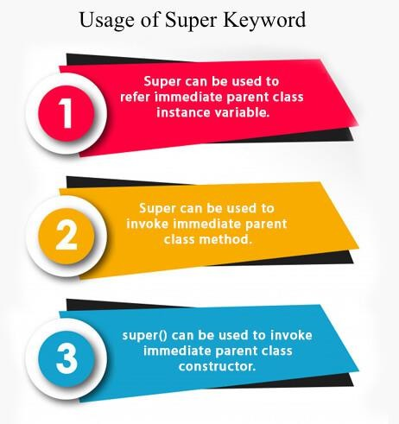
Covariant Return Type
The covariant return type specifies that the return type may vary in the same direction as the subclass.
Super Keyword in Java
The super keyword in Java is a reference variable which is used to refer immediate parent class object.
Instance initializer block
Instance Initializer block is used to initialize the instance data member. It run each time when object of the class is created.
Final Keyword in Java
The final keyword in java is used to restrict the user. The java final keyword can be used in many context. Final can be:
variable
method

Slide 33
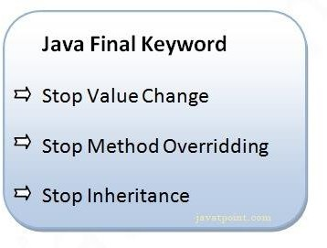
3. class
1) Java final variable
If you make any variable as final, you cannot change the value of final variable(It will be constant).
Java final method
If you make any method as final, you cannot override it.
Java final class
If you make any class as final, you cannot extend it.
Q) Is final method inherited?
Ans) Yes, final method is inherited but you cannot override it.
Q) What is blank or uninitialized final variable?
A final variable that is not initialized at the time of declaration is known as blank final variable.
Q) Can we initialize blank final variable?
Yes, but only in constructor.
Q) What is final parameter?
If you declare any parameter as final, you cannot change the value of it.

Slide 34
Can we declare a constructor final?
No, because constructor is never inherited.
Polymorphism in Java
Polymorphism in Java is a concept by which we can perform a single action in different ways.
There are two types of polymorphism in Java: compile-time polymorphism and runtime polymorphism. We can perform polymorphism in java by method overloading and method overriding.
Runtime Polymorphism in Java
Runtime polymorphism or Dynamic Method Dispatch is a process in which a call to an overridden method is resolved at runtime rather than compile-time.

Slide 35
Java Abstraction
Abstract class in Java
A class which is declared with the abstract keyword is known as an abstract class in Java. It can have abstract and non-abstract methods (method with the body).

Slide 36
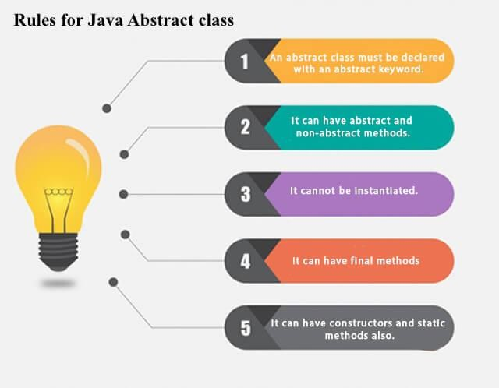
Abstraction in Java
Abstraction is a process of hiding the implementation details and showing only functionality to the user.
Ways to achieve Abstraction
There are two ways to achieve abstraction in java
Abstract class (0 to 100%)
Interface (100%)
Abstract Method in Java
A method which is declared as abstract and does not have implementation is known as an abstract method.
Interface in Java
An interface in Java is a blueprint of a class. It has static constants and abstract methods.

Slide 37
Why use Java interface?
The interface in Java is a mechanism to achieve abstraction. There can be only abstract methods in the Java interface, not method body. It is used to achieve abstraction and multiple inheritance in Java.
There are mainly three reasons to use interface. They are given below.
It is used to achieve abstraction.
By interface, we can support the functionality of multiple inheritance.
It can be used to achieve loose coupling.
Syntax:
interface <interface_name>{
// declare constant fields
// declare methods that abstract
// by default.
}
Q) What is marker or tagged interface?
An interface which has no member is known as a marker or tagged interface, for example, Serializable, Cloneable, Remote, etc. They are used to provide some essential information to the JVM so that JVM may perform some useful operation.
Difference between abstract class and interface
Abstract class | Interface
1) Abstract class can have abstract and non-abstract methods. | Interface can have only abstract methods. Since Java 8, it can have default and static methods also.
2) Abstract class doesn't support multiple inheritance. | Interface supports multiple inheritance.

Slide 38
3) Abstract class can have final, non- final, static and non-static variables. | Interface has only static and final variables.
4) Abstract class can provide the implementation of interface. | Interface can't provide the implementation of abstract class.
5) The abstract keyword is used to declare abstract class. | The interface keyword is used to declare interface.
6) An abstract class can extend another Java class and implement multiple Java interfaces. | An interface can extend another Java interface only.
7) An abstract class can be extended using keyword "extends". | An interface can be implemented using keyword "implements".
8) A Java abstract class can have class members like private, protected, etc. | Members of a Java interface are public by default.
9)Example: public abstract class Shape{ public abstract void draw(); } | Example: public interface Drawable{ void draw(); }
Simply, abstract class achieves partial abstraction (0 to 100%) whereas interface achieves fully abstraction (100%).
Java Encapsulation
Java Package
A java package is a group of similar types of classes, interfaces and sub- packages.
Package in java can be categorized in two form, built-in package and user- defined package.
There are many built-in packages such as java, lang, awt, javax, swing, net, io, util, SQL etc.

Slide 39
Sub package in java
Package inside the package is called the sub package. It should be created to categorize the package further.
Access Modifiers in Java
There are two types of modifiers in Java: access modifiers and non-access modifiers.
There are four types of Java access modifiers:
Private: The access level of a private modifier is only within the class. It cannot be accessed from outside the class.
Default: The access level of a default modifier is only within the package. It cannot be accessed from outside the package. If you do not specify any access level, it will be the default.
Protected: The access level of a protected modifier is within the package and outside the package through child class. If you do not make the child class, it cannot be accessed from outside the package.
Public: The access level of a public modifier is everywhere. It can be accessed from within the class, outside the class, within the package and outside the package.
Access Modifier | within class | within outside package by subclass only package |  | outside package
Private | Y | N | N | N
Default | Y | Y | N | N
Protected | Y | Y | Y | N
Public | Y | Y | Y | Y
Encapsulation in Java

Slide 40
Encapsulation in Java is a process of wrapping code and data together into a single unit, for example, a capsule which is mixed of several medicines.
Advantage of Encapsulation in Java
By providing only a setter or getter method, you can make the class read- only or write-only. In other words, you can skip the getter or setter methods.
It provides you the control over the data. Suppose you want to set the value of id which should be greater than 100 only, you can write the logic inside the setter method.
It is a way to achieve data hiding in Java because other class will not be able to access the data through the private data members.
Java Array
Java Arrays
Java array is an object which contains elements of a similar data type. Additionally, The elements of an array are stored in a contiguous memory location. It is a data structure where we store similar elements. We can store only a fixed set of elements in a Java array.
Array in Java is index-based, the first element of the array is stored at the 0th index, 2nd element is stored on 1st index and so on.
Advantages
Code Optimization: It makes the code optimized, we can retrieve or sort the data efficiently.
Random access: We can get any data located at an index position.
Disadvantages
Size Limit: We can store only the fixed size of elements in the array. It doesn't grow its size at runtime. To solve this problem, collection framework is used in Java which grows automatically.

Slide 41
Types of Array in java
There are two types of array.
Single Dimensional Array
Multidimensional Array

Slide 42
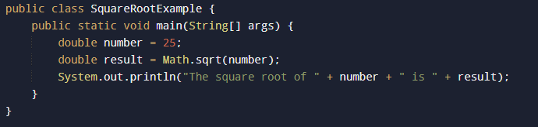

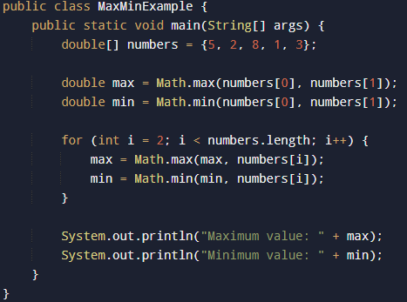
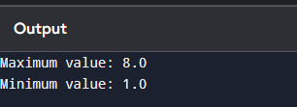
Java Math class
Java Math class provides several methods to work on math calculations like min(), max(), avg(), sin(), cos(), tan(), round(), ceil(), floor(), abs() etc.
Unlike some of the Strict Math class numeric methods, all implementations of the equivalent function of Math class can't define to return the bit-for-bit same results.

Slide 43
Difference between object and class
No. Object |  | Class
1) | Object is an instance of a class. | Class is a blueprint or template from which objects are created.
2) | Object is a real world entity such as pen, laptop, mobile, bed, keyboard, mouse, chair etc. | Class is a group of similar objects.
3) | Object is a physical entity. | Class is a logical entity.
4) | Object is created through new keyword mainly e.g. Student s1=new Student(); | Class is declared keyword e.g. class Student{} | using class
5) | Object is created many times as per requirement. | Class is declared once.
6) | Object allocates memory when it is created. | Class doesn't allocated when it is created. | memory
7) | There are many ways to create object in java such as new keyword, newInstance() method, clone() method, factory method and deserialization. | There is only one way to define class in java using class keyword.

Slide 44
Difference between method overloading and method overriding in java
No. | Method Overloading | Method Overriding
1) | Method overloading is used to increase the readability of the program. | Method overriding is used to provide the specific implementation of the method that is already provided by its super class.
2) | Method overloading is performed within class. | Method overriding occurs in two classes that have IS-A (inheritance) relationship.
3) | In case of method overloading, parameter must be different. | In case of method overriding, parameter must be same.
4) | Method overloading is the example of compile time polymorphism. | Method overriding is the example of run time polymorphism.
5) | In java, method overloading can't be performed by changing return type of the method only. Return type can be same or different in method overloading. But you must have to change the parameter. | Return type must be same or covariant in method overriding.
Java String
Java String
In Java, string is basically an object that represents sequence of char values. An array of characters works same as Java string. For example:

Slide 45
char[] ch={'j','a','v','a','t','p','o','i','n','t'}; String s=new String(ch);
How to create a string object?
There are two ways to create String object:
By string literal
By new keyword
1) String Literal
Java String literal is created by using double quotes. For Example:
1. String s="welcome";
2) By new keyword
1. String s=new String("Welcome");//creates two objects and one reference va riable
Immutable String in Java
A String is an unavoidable type of variable while writing any application program. String references are used to store various attributes like username, password, etc. In Java, String objects are immutable.
Immutable simply means unmodifiable or unchangeable.
Java String Buffer Class
Java String Buffer class is used to create mutable (modifiable) String objects. The String Buffer class in Java is the same as String class except it is mutable
i.e. it can be changed.
Java StringBuilder Class

Slide 46
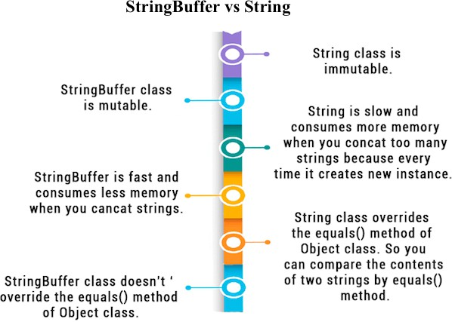
Java StringBuilder class is used to create mutable (modifiable) String. The Java StringBuilder class is same as StringBuffer class except that it is non- synchronized. It is available since JDK 1.5.
Difference between String and String Buffer
Difference between StringBuffer and StringBuilder
StringBuffer Class | StringBuilder Class
StringBuffer is present in Java. | StringBuilder was introduced in Java 5.
StringBuffer is synchronized. This means that multiple threads cannot call the methods of StringBuffer simultaneously. | StringBuilder is asynchronized. This means that multiple threads can call the methods of StringBuilder simultaneously.

Slide 47
StringBuffer Class | StringBuilder Class
Due to synchronization, StringBuffer is called a thread safe class. | Due to its asynchronous nature, StringBuilder is not a thread safe class.
Due to synchronization, StringBuffer is lot slower than StringBuilder. | Since there is no preliminary check for multiple threads, StringBuilder is a lot faster than StringBuffer.
How to create Immutable class?
There are many immutable classes like String, Boolean, Byte, Short, Integer, Long, Float, Double etc. In short, all the wrapper classes and String class is immutable.
Java toString() Method
If you want to represent any object as a string, toString() method comes into existence.
The toString() method returns the String representation of the object.
If you print any object, Java compiler internally invokes the toString() method on the object.
Advantage of Java toString() method
By overriding the toString() method of the Object class, we can return values of the object, so we don't need to write much code.
StringTokenizer in Java
The java.util.StringTokenizer class allows you to break a String into tokens. It is simple way to break a String. It is a legacy class of Java.

Slide 48
Exception Handling
Exception Handling in Java
The Exception Handling in Java is one of the powerful mechanism to handle the runtime errors so that the normal flow of the application can be maintained.
What is Exception in Java?
an exception is an event that disrupts the normal flow of the program. It is an object which is thrown at runtime.
Types of Java Exceptions
There are mainly two types of exceptions: checked and unchecked. An error is considered as the unchecked exception. However, according to Oracle, there are three types of exceptions namely:
Checked Exception
Unchecked Exception
Error
Difference between Checked and Unchecked Exceptions
Checked Exception
The classes that directly inherit the Throwable class except Runtime Exception and Error are known as checked exceptions. For example, IO Exception, SQL Exception, etc. Checked exceptions are checked at compile- time.
Unchecked Exception
The classes that inherit the Runtime Exception are known as unchecked exceptions. For example, Arithmetic Exception, NullPointerException,

Slide 49
ArrayIndexOutOfBoundsException, etc. Unchecked exceptions are not checked at compile-time, but they are checked at runtime.
3) Error
Error is irrecoverable. Some example of errors are OutOfMemoryError, VirtualMachineError, AssertionError etc.
Java try-catch block
Java try block
Java try block is used to enclose the code that might throw an exception. It must be used within the method.
Syntax of Java try-catch try{
//code that may throw an exception
}catch(Exception_class_Name ref){}
Java catch block
Java catch block is used to handle the Exception by declaring the type of exception within the parameter.
The catch block must be used after the try block only. You can use multiple catch block with a single try block.
Java Catch Multiple Exceptions Java Multi-catch block
A try block can be followed by one or more catch blocks. Each catch block must contain a different exception handler. So, if you have to perform different tasks at the occurrence of different exceptions, use java multi-catch block.
Java Nested try block

Slide 50
In Java, using a try block inside another try block is permitted. It is called as nested try block.
Why use nested try block
Sometimes a situation may arise where a part of a block may cause one error and the entire block itself may cause another error. In such cases, exception handlers have to be nested.
Java finally block
Java finally block is a block used to execute important code such as closing the connection, etc.
Java finally block is always executed whether an exception is handled or not.
Why use Java finally block?
finally block in Java can be used to put "cleanup" code such as closing a file, closing connection, etc.
The important statements to be printed can be placed in the finally block.
Usage of Java finally
Let's see the different cases where Java finally block can be used.
Java throw keyword
The Java throw keyword is used to throw an exception explicitly.
We can throw either checked or unchecked exceptions in Java by throw keyword. It is mainly used to throw a custom exception.
Java Exception Propagation
Exception propagation in Java occurs when an exception thrown from the top of the stack.

Slide 51
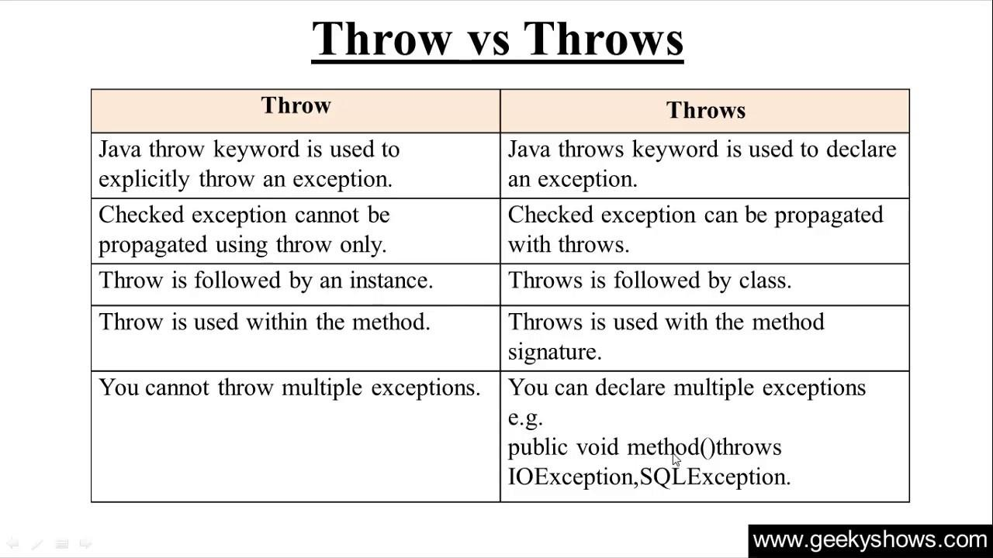
Java throws keyword
The Java throws keyword is used to declare an exception. It gives an information to the programmer that there may occur an exception.
Syntax of Java throws
return_type method_name() throws exception_class_name{
//method code
}
Difference between throw and throws in Java

Slide 52
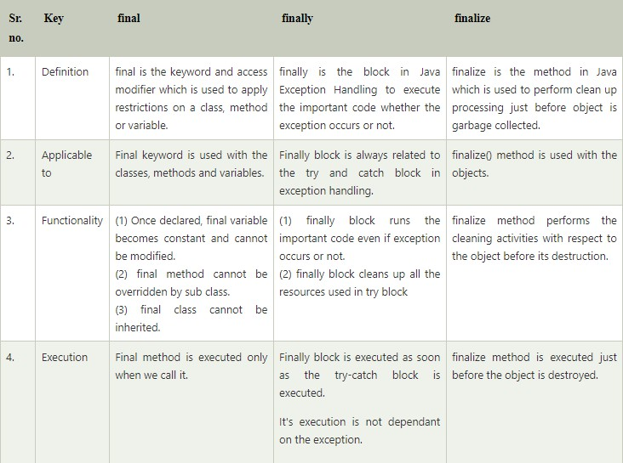
Difference between final, finally and finalize
Java Custom Exception
Creating our own Exception is known as custom exception or user-defined exception. Basically, Java custom exceptions are used to customize the exception according to user need.
Why use custom exceptions?
Java exceptions cover almost all the general type of exceptions that may occur in the programming.
However, we sometimes need to create custom exceptions.

Slide 53
Thread. Sleep() in Java
The Java Thread class provides the two variant of the sleep() method. First one accepts only an arguments, whereas the other variant accepts two arguments. The method sleep() is being used to halt the working of a thread for a given amount of time. The time up to which the thread remains in the sleeping state is known as the sleeping time of the thread. After the sleeping time is over, the thread starts its execution from where it has left.
The sleep() Method Syntax:
Following are the syntax of the sleep() method.
public static void sleep(long mls) throws InterruptedException
public static void sleep(long mls, int n) throws InterruptedException
Can we start a thread twice
No. After starting a thread, it can never be started again. If you does so, an IllegalThreadStateException is thrown. In such case, thread will run once but for second time, it will throw exception.

Slide 54
Java Collections
Collections in Java
The Collection in Java is a framework that provides an architecture to store and manipulate the group of objects.
Java Collections can achieve all the operations that you perform on a data such as searching, sorting, insertion, manipulation, and deletion.
Java Collection means a single unit of objects. Java Collection framework provides many interfaces (Set, List, Queue, Deque) and classes (ArrayList, Vector, LinkedList, PriorityQueue, HashSet, LinkedHashSet, TreeSet).
What is Collection in Java
A Collection represents a single unit of objects, i.e., a group.
What is a framework in Java
It provides readymade architecture.
It represents a set of classes and interfaces.
It is optional.
What is Collection framework
The Collection framework represents a unified architecture for storing and manipulating a group of objects. It has:
Interfaces and its implementations, i.e., classes
Algorithm
1) Java ArrayList
Java ArrayList class uses a dynamic array for storing the elements. It is like an array, but there is no size limit. We can add or remove elements anytime. So, it is much more flexible than the

Slide 55
traditional array. It is found in the java.util package. It is like the Vector in C++.
We can not create an array list of the primitive types, such as int, float, char, etc. It is required to use the required wrapper class in such cases. For example:
ArrayList<int> al = ArrayList<int>(); // does not work
ArrayList<Integer> al = new ArrayList<Integer>(); // works fine
ArrayList class declaration
Let's see the declaration for java.util.ArrayList class.
1. public class ArrayList<E> extends AbstractList<E> implements List
<E>, RandomAccess, Cloneable, Ser
Java Non-generic Vs. Generic Collection
Java collection framework was non-generic before JDK 1.5. Since 1.5, it is generic.
Java new generic collection allows you to have only one type of object in a collection. Now it is type-safe, so typecasting is not required at runtime.
Let's see the old non-generic example of creating a Java collection.
1. ArrayList list=new ArrayList();//creating old non-generic arraylist Let's see the new generic example of creating java collection.
1. ArrayList<String> list=new ArrayList<String>();//creating new gener ic arraylist

Slide 56
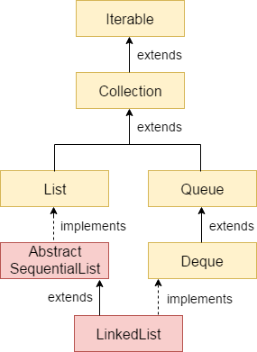
2) Java LinkedList class
Java LinkedList class uses a doubly linked list to store the elements. It provides a linked-list data structure. It inherits the Abstract List class and implements List and Deque interfaces.
The important points about Java LinkedList are:
Java LinkedList class can contain duplicate elements.
Java LinkedList class maintains insertion order.
Java LinkedList class is non synchronized.
In Java LinkedList class, manipulation is fast because no shifting needs to occur.
Java LinkedList class can be used as a list, stack or queue.
Hierarchy of LinkedList class
As shown in the above diagram, Java LinkedList class extends AbstractSequentialList class and implements List and Deque interfaces.

Slide 57

Doubly Linked List
In the case of a doubly linked list, we can add or remove elements from both sides.
LinkedList class declaration
Let's see the declaration for java.util.LinkedList class.
1. public class LinkedList<E> extends AbstractSequentialList<E> impl ements List<E>, Deque<E>, Clonea
Difference Between ArrayList and LinkedList
ArrayList | LinkedList
1) ArrayList internally uses a dynamic array to store the elements. | LinkedList internally uses a doubly linked list to store the elements.
2) Manipulation with ArrayList is slow because it internally uses an array. If any element is removed from the array, all the other elements are shifted in memory. | Manipulation with LinkedList is faster than ArrayList because it uses a doubly linked list, so no bit shifting is required in memory.
3) An ArrayList class can act as a list only because it implements List only. | LinkedList class can act as a list and queue both because it implements List and Deque interfaces.
4) ArrayList is better for storing and accessing data. | LinkedList is better for manipulating data.

Slide 58
Java List
5) The memory location for the elements of an ArrayList is contiguous. | The location for the elements of a linked list is not contagious.
6) Generally, when an ArrayList is initialized, a default capacity of 10 is assigned to the ArrayList. | There is no case of default capacity in a LinkedList. In LinkedList, an empty list is created when a LinkedList is initialized.
7) To be precise, an ArrayList is a resizable array. | LinkedList implements the doubly linked list of the list interface.
List in Java provides the facility to maintain the ordered collection. It contains the index-based methods to insert, update, delete and search the elements. It can have the duplicate elements also. We can also store the null elements in the list.
The List interface is found in the package and inherits the Collection
java.util
interface. It is a factory of ListIterator interface. Through the ListIterator, we can iterate the list in forward and backward directions. The implementation classes of List interface are ArrayList, LinkedList, Stack and Vector. The ArrayList and LinkedList are widely used in Java programming. The Vector class is deprecated since Java 5.
Java HashSet
Java HashSet class is used to create a collection that uses a hash table for storage. It inherits the AbstractSet class and implements Set interface.

Slide 59
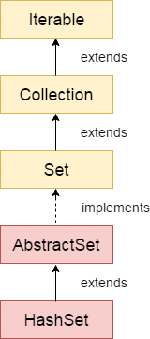
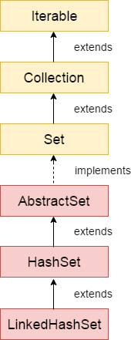
The important points about Java HashSet class are:
HashSet stores the elements by using a mechanism called hashing.
HashSet contains unique elements only.
HashSet allows null value.
HashSet class is non synchronized.
HashSet doesn't maintain the insertion order. Here, elements are inserted on the basis of their hashcode.
HashSet is the best approach for search operations.
The initial default capacity of HashSet is 16, and the load factor is 0.75.
Java LinkedHashSet Class

